Slide 1
71 (Inspection & Repair) Sqn Non-Destructive Testing
Petty Officer AET(M)
Air Engineering Technician (Mechanical)
Martin Dodd
Notes:
Good Morning/Afternoon my name is Petty Officer Martin Dodd. I have been a serving member of the Royal Navy for 20 years and have been an NDT technician for approximately 6 years during this time I have been deployed onboard ship as the sole level 2 technician during both exercises and as part of a task group comprising multiple ships and aircraft. I have also been based at an Air station within a regional team before moving to the technical support team at RAF Wittering. I currently hold 4 Method L2 qualifications and one L3 in Eddy current testing. I am working towards a fifth L2 qualification and a second L3 in Magnetic testing.

Slide 2
Delivery of NDT within the MOD (Specifically Air Command)
Objectives:
To give an oversight of the organisational construct of NDT within the MOD.
To give basic details of the process used with Air Command for task request through to task completion.
Notes:
The objectives of this presentation are to give an overview of NDT Delivery within the Ministry of Defence including the construct and hierarchy within.
I will specifically be concentrating on the Air command delivery with whom I currently work. as these differ from Navy Command.

Slide 3
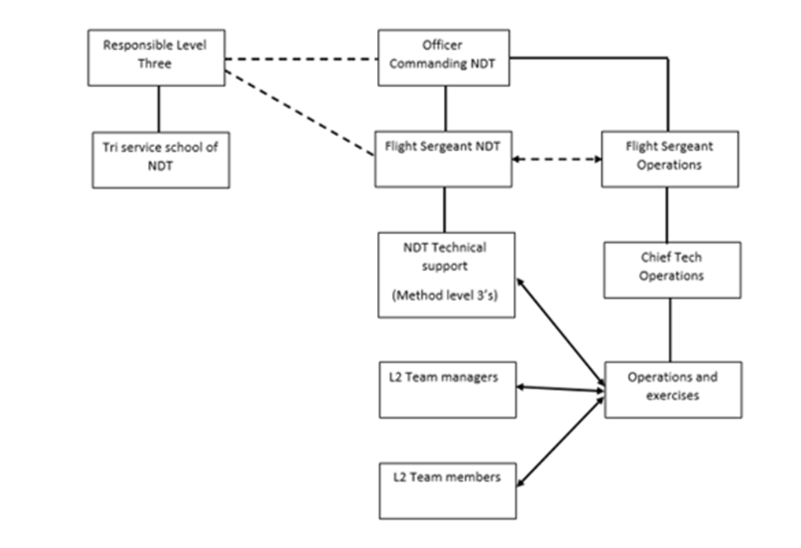
Air Command Non-Destructive testing hierarchical construct.
Notes:
THE MOD has TWO distinctive structures within NDT which are
AIR Command which looks after all fixed wing assets and operationally deployed rotary wing assets of the MOD.
Navy command look after rotary wing assets for both Navy command, land and Joint helicopter command on rotary wing assets within the UK and on exercise.
Air command is made up of approximately 35 NDT Technicians spread over 5 locations within the UK. This includes the L3 technicians both in the technical support section and on the teams as well as the L2 Technicians.
The personnel who are deployed on operations and exercise are also taken from this pool of manpower.
OFFICER COMMANDING NDT is the functional head of NDT within the wider squadron and military construct. Dealing with Operational movements and authorisations to move personnel throughout the world. a task more onerous than usual over the last year due to COVID.
They also have the overarching control when it comes to extra tasking and external requirements on the people in his chain of command. Including carrying out internal audits of the fwd deployed teams.
The Flight sergeant NDT has day to day control of the NDT technicians within the Technical support team and Fwd deployed teams. Ensuring that each team has the correct people available for tasking, they can also stand in for the officer commanding NDT should it be required. They also have the military aspects of the position to deal with as well. These include but are not limited to report writing, military ethos, substituting for the SQN Warrant officer in his
absence should it be required.
The NDT Tech support section is made up of 5 NDT technicians all holding differing level 3 qualifications in addition to multi method level 2 qualifications. As well as carrying out the role of LEVEL 3 technicians the tech support team also carry out assisting with procurement, liasing with industry when required, providing of examiners for the tri service school of NDT and deploying on operations when rota’d to do so.
The L2 team managers are responsible for the personnel within their teams and ensuring that the correct people are available to be able to fulfil routine tasking. Non routine tasking by its nature can occur any time and it will be down to the team manager to balance the expectation of the customer with personnel requirements.
The team members within the 5 fwd teams are a mixture of qualified and personnel under training. The qualified team members are responsible for carrying out the tasking received, submitting a Form 7 Non Routine NDT request form. (I will go into more detail of this form later. ) They are also responsible for supplying reports to customers as required.
There are also a team of personal taken from the 35 that are titled the specialist non destructive test team these are the Radiographic specialist team that carry out all Radiographs throughout Air Command with guidance from the appropriate method L3
The trainees in the teams are required to shadow qualified personnel to gain the requisite hours to gain qualification after all required examinations and experience have been gained.
The Flight sergeant and chief tech Operations are responsible for ensuring that the teams are correctly manned and that the personnel have the correct qualifications to carry out the tasking within their area of operations. This is a forever evolving manpower plot. But is loosely planned for up to two years in advance. But being humans things change. With extra requirements to send people away out of sequence or at short notice depending on emergent tasking.

Slide 4
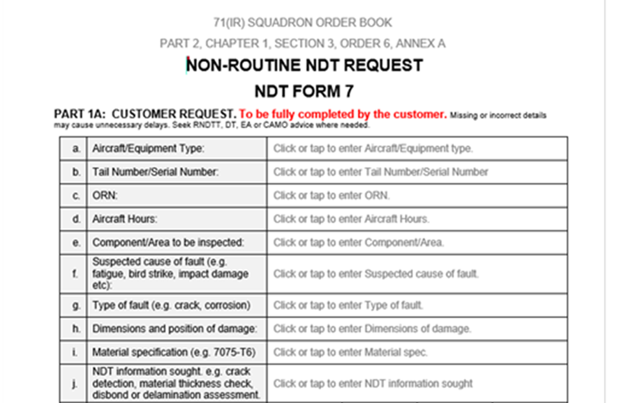
NDT Form 7 Non routine NDT Request Form
Notes:
A form 7 is the Form that is used when a non-routine NDT request is submitted. I have cropped the form into parts due to being able to show it more clearly on the presentation. Apologies for this but I wanted to make it as clear as possible for people to see. It is a generic form used across all platforms within the AIR COMMAND environment.
It is important to distinguish between a specific and generic NDI procedure
A specific NDI is where the NDI is applicable to a particular aircraft type or component and the region of interest or the scan area is detailed. Specific NDI procedures are generally published in the relevant manufacturer schedules,
A Generic Non-destructive inspection is where the NDT procedure is generally applicable to materials or construction types. Before use the region of interest or scan area is to be detailed as per the form 7.
Part one is filled in by the customer requiring the NDT to be carried out. It gives both the fwd team at the AIR station and the method level 3’s most of the generic information required to be able to assist them in making a decision later as to whether or not authorize the task.

Slide 5
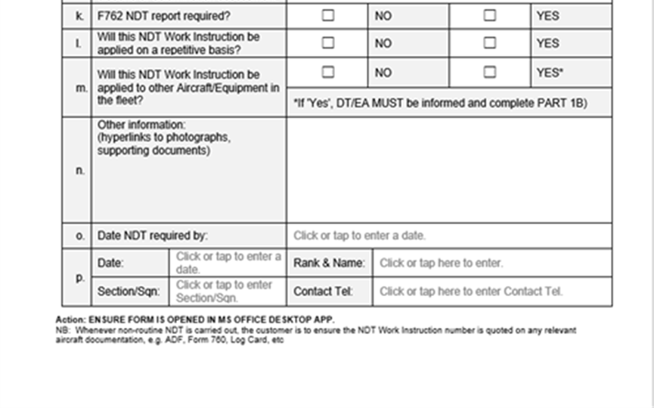
NDT Form 7continued
Notes:
Most of the information is basic IE airframe side number airframe hours etc. we usually ask that an image of the area of interest is also inserted into the required document. Any information available from the customer possible from the relevant aircraft manuals may also be inputted into this form.
In accordance with the Manual of airworthiness maintenance 48 hours notice is required to carry out NDT tasking. This however is very often reduced and the tasking is carried out as soon as practicable.
The form 7 is completed electronically and sent from the customer to the appropriate supporting team. The form is a locked form and at each stage should only be editable in the correct stages to ensure no corrupt data is inputted.

Slide 6
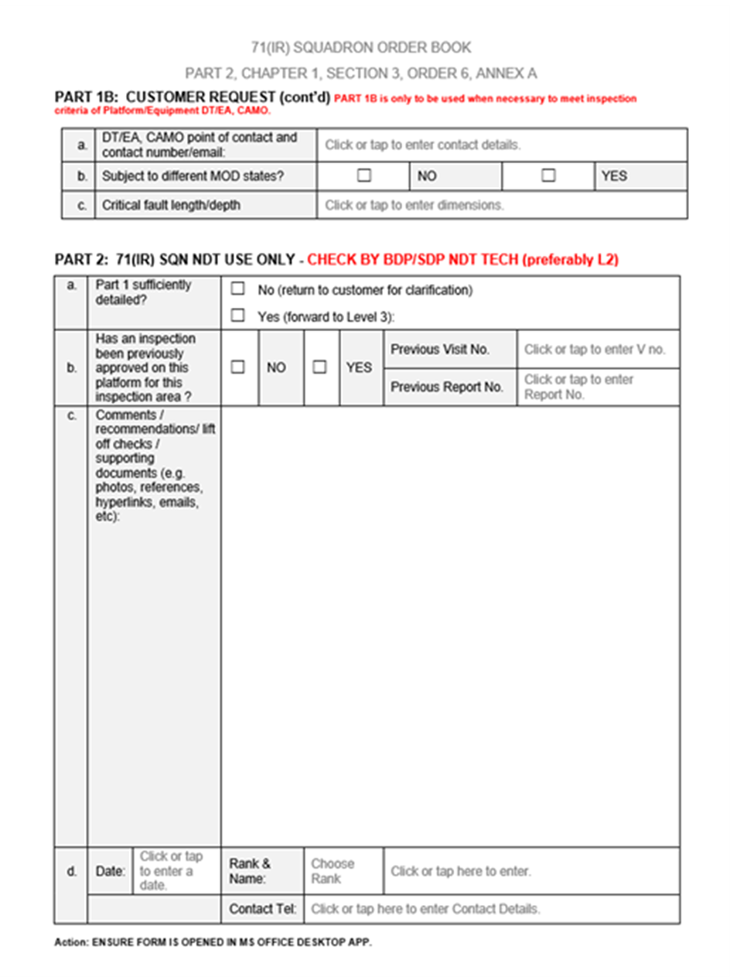
NDT Form 7 continued
Notes:
The EN4179 Level 2 skillset includes the ability to interpret and apply NDT WIs from any source however Part 2 of the form is used by the L2 NDT technician who will check to ensure that the customer has completed part 1 correctly. They will also carry out a check of the Sqn database to see if the check has been previously authorised. It is also advised that they visit the aircraft if possible to ensure that there are no hidden issues that may have been missed.

Slide 7
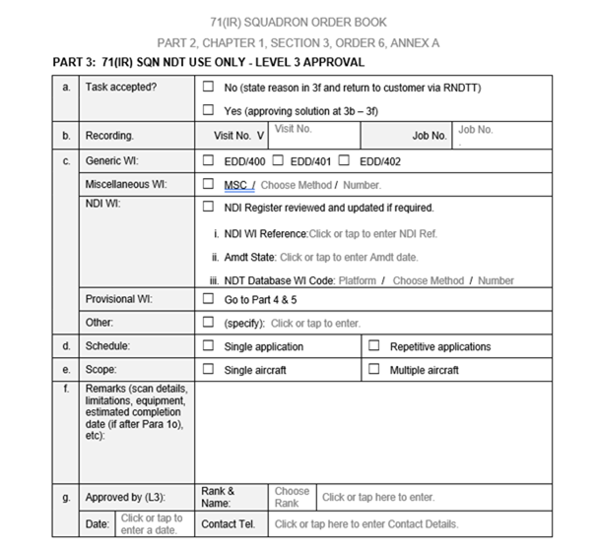
NDT Form 7 Continued
Notes:
The L3 carries out the final layer of checks prior to approving the NDT method required if it is deemed the most appropriate.
The checks typically include but are not limited to
Health and safety, access to the area under test and any preparation issues are resolved.
Service NDT equipment is permitted for use with the NDI procedure.
Service NDT equipment is compatible and can achieve sensitivity equivalent to (or better than) the NDI procedure.
Ensuring that the L2 has the required qualifications to carry out the tasking.
Ensuring if the tasking is deemed Generic that the scan area or area of interest is detailed on the form 7.
Ensuring that any details on a service bulletin are sufficiently detailed as to be able to cross reference them on the form 7.
If the appropriate people are in place and the documentation available we aim to give approval as quickly and safely as possible and never rely on the 48 hour window available.

Slide 8
Preliminary Work Instruction (PWI).
Used only under the authority of the appropriate Level J authorisation holder calling for the inspection. If there is no Level 3 approval available for the WI.
The Level J may authorise the use of a Provisional WI by recording it as an Acceptable Deferred Fault (ADF) in the appropriate aircraft MF700C.
On obtaining Level 3 approval, the ADF may be closed
Notes:
In the rare, unlikely circumstances where Level 3 cover may not be available, resulting in the inability to follow the formalised Form 7 process and Providing Operation neccessity dictates, a suitable PWI may be formulated by the Level 2 Technician, providing strict criteria is followed a level 2 may write and carry out a provisional WI. This has to be authorised by the relevant squadron senior engineering oficer and an entry raised in the aircraft documentation that cannot be closed until a full Level 3 approval of the Work instruction has taken place.

Slide 9
Formal Work Instruction.
Usually requested by Engineering Authority
Formally entered the relevant Aircraft maintenance documentation.
Becomes proprietary document of the maintenance documentation sponsor
Any requests are to be carried out formally.
Notes:
Tasking is carried out in accordance with the higher documentation the MAM-P.
The Flight Sergeant NDT ensures that the task is raised in the tasking database and that the method requested is appropriate along with the method Level 3’s
A formal task acceptance letter is sent out to the authority requesting tasking detailing the relevant database code and the expected manhours required to carry out the tasking. This will vary given the complexity of the task.
The Flight Sergeant NDT will assign an appropriate method L3 to carry out the development work.
Once the WI has been developed it will be validated by at least a method L2 in the same method.
A task completion letter is to be issued to the originating sponsor. Attached with the WI.
The sponsor can then decide if this will be issued straight away or wait until a formal update of the maintenance manual is carried out.
This is a large task within its own right and more details can be provided if anyone would like more information.

Slide 10
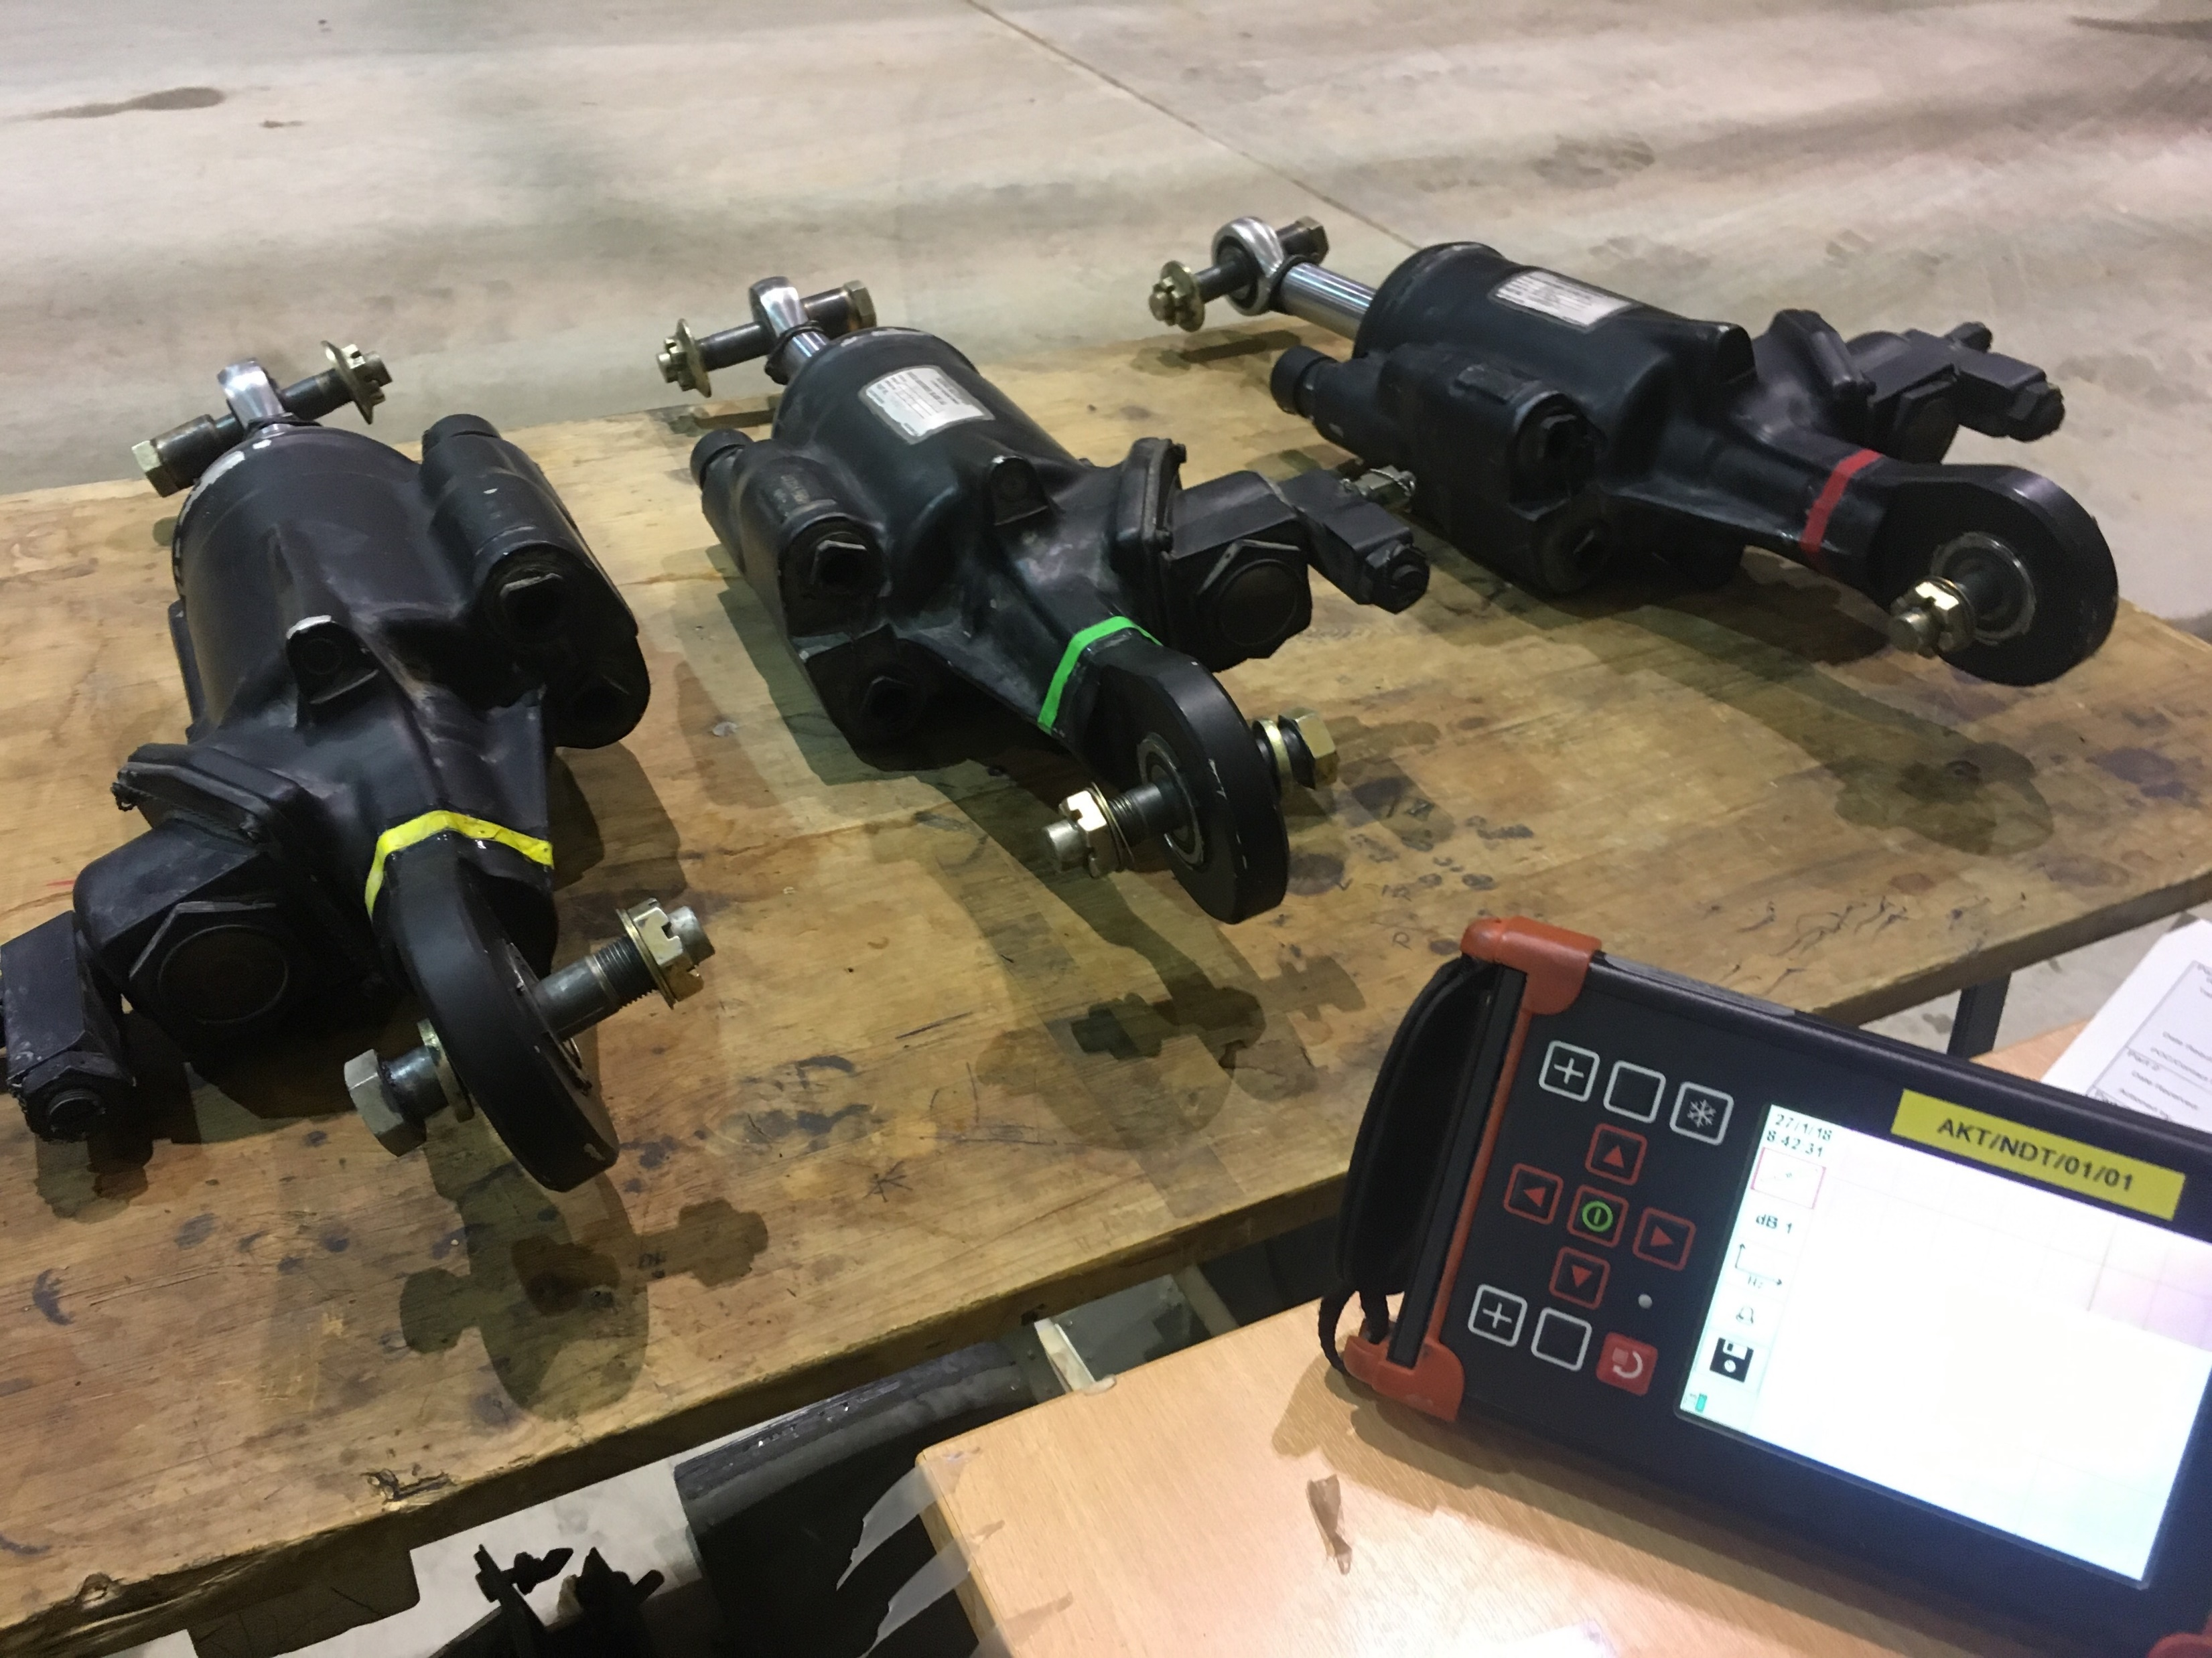
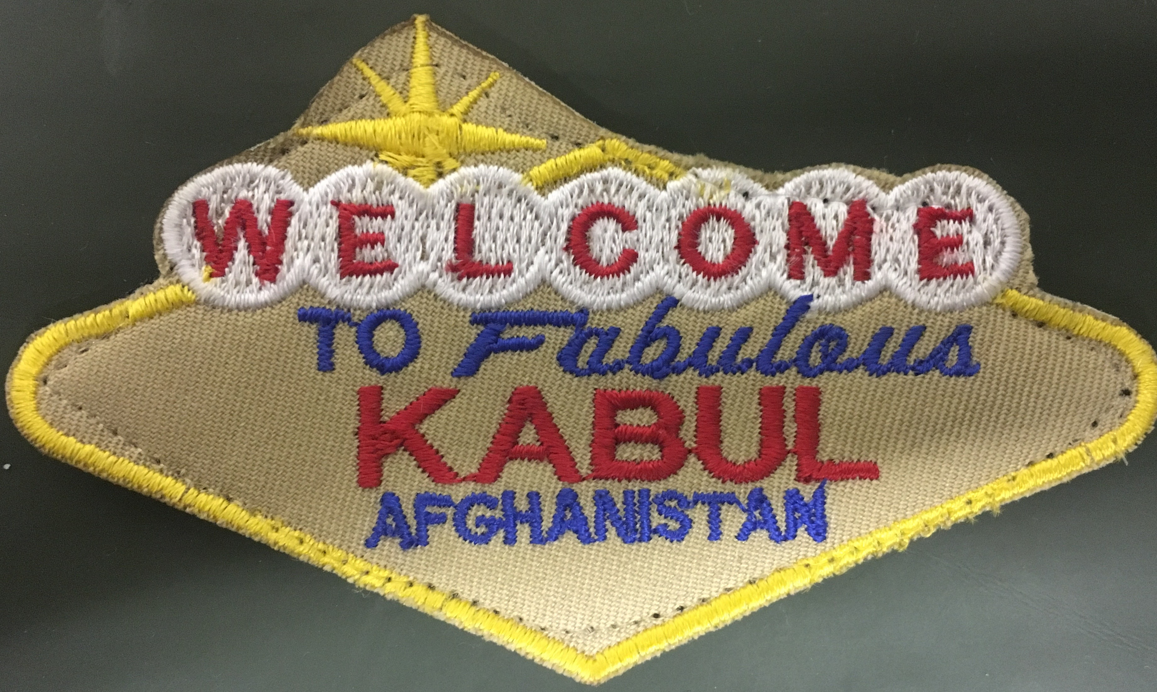
Examples of NDT carried out within the MOD
Notes:
Over the next few slides I have put a few images in to show NDT being carried out whilst on Operations. These are from a Chinook task carried out in Afghanistan during routine maintaenance. As previously discussed this tasking would have been organised by the operations team. With a sole NDT technician deploying forward to carry out the tasking on this and other assets whilst operating solely without immediate support or back up.

Slide 11
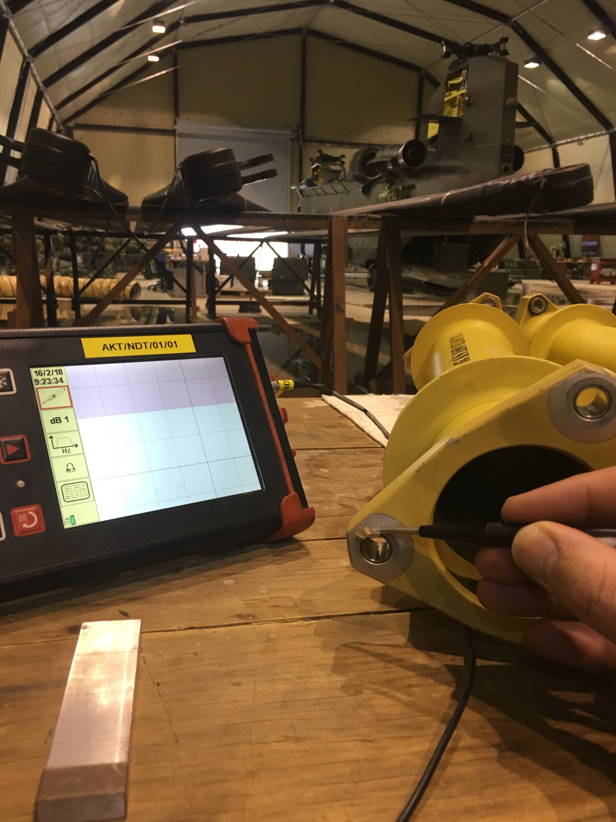
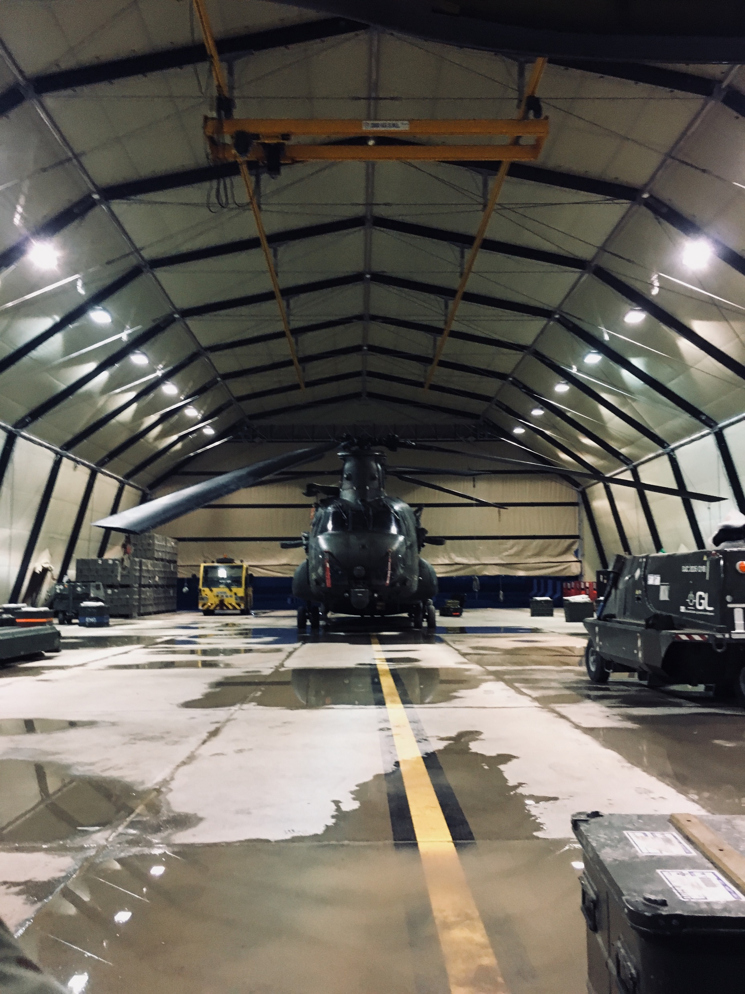
Examples of NDT carried out within the MOD
Notes:
These are from a Chinook task carried out in Afghanistan during routine maintaenance. As previously discussed this tasking would have been organised by the operations team. With a sole NDT technician deploying forward to carry out the tasking on this and other assets whilst operating solely without immediate support or back up. It is down to the individual technician to ensure that all of the equipment is in theatre to allow for there inspections to be carried out.

Slide 12
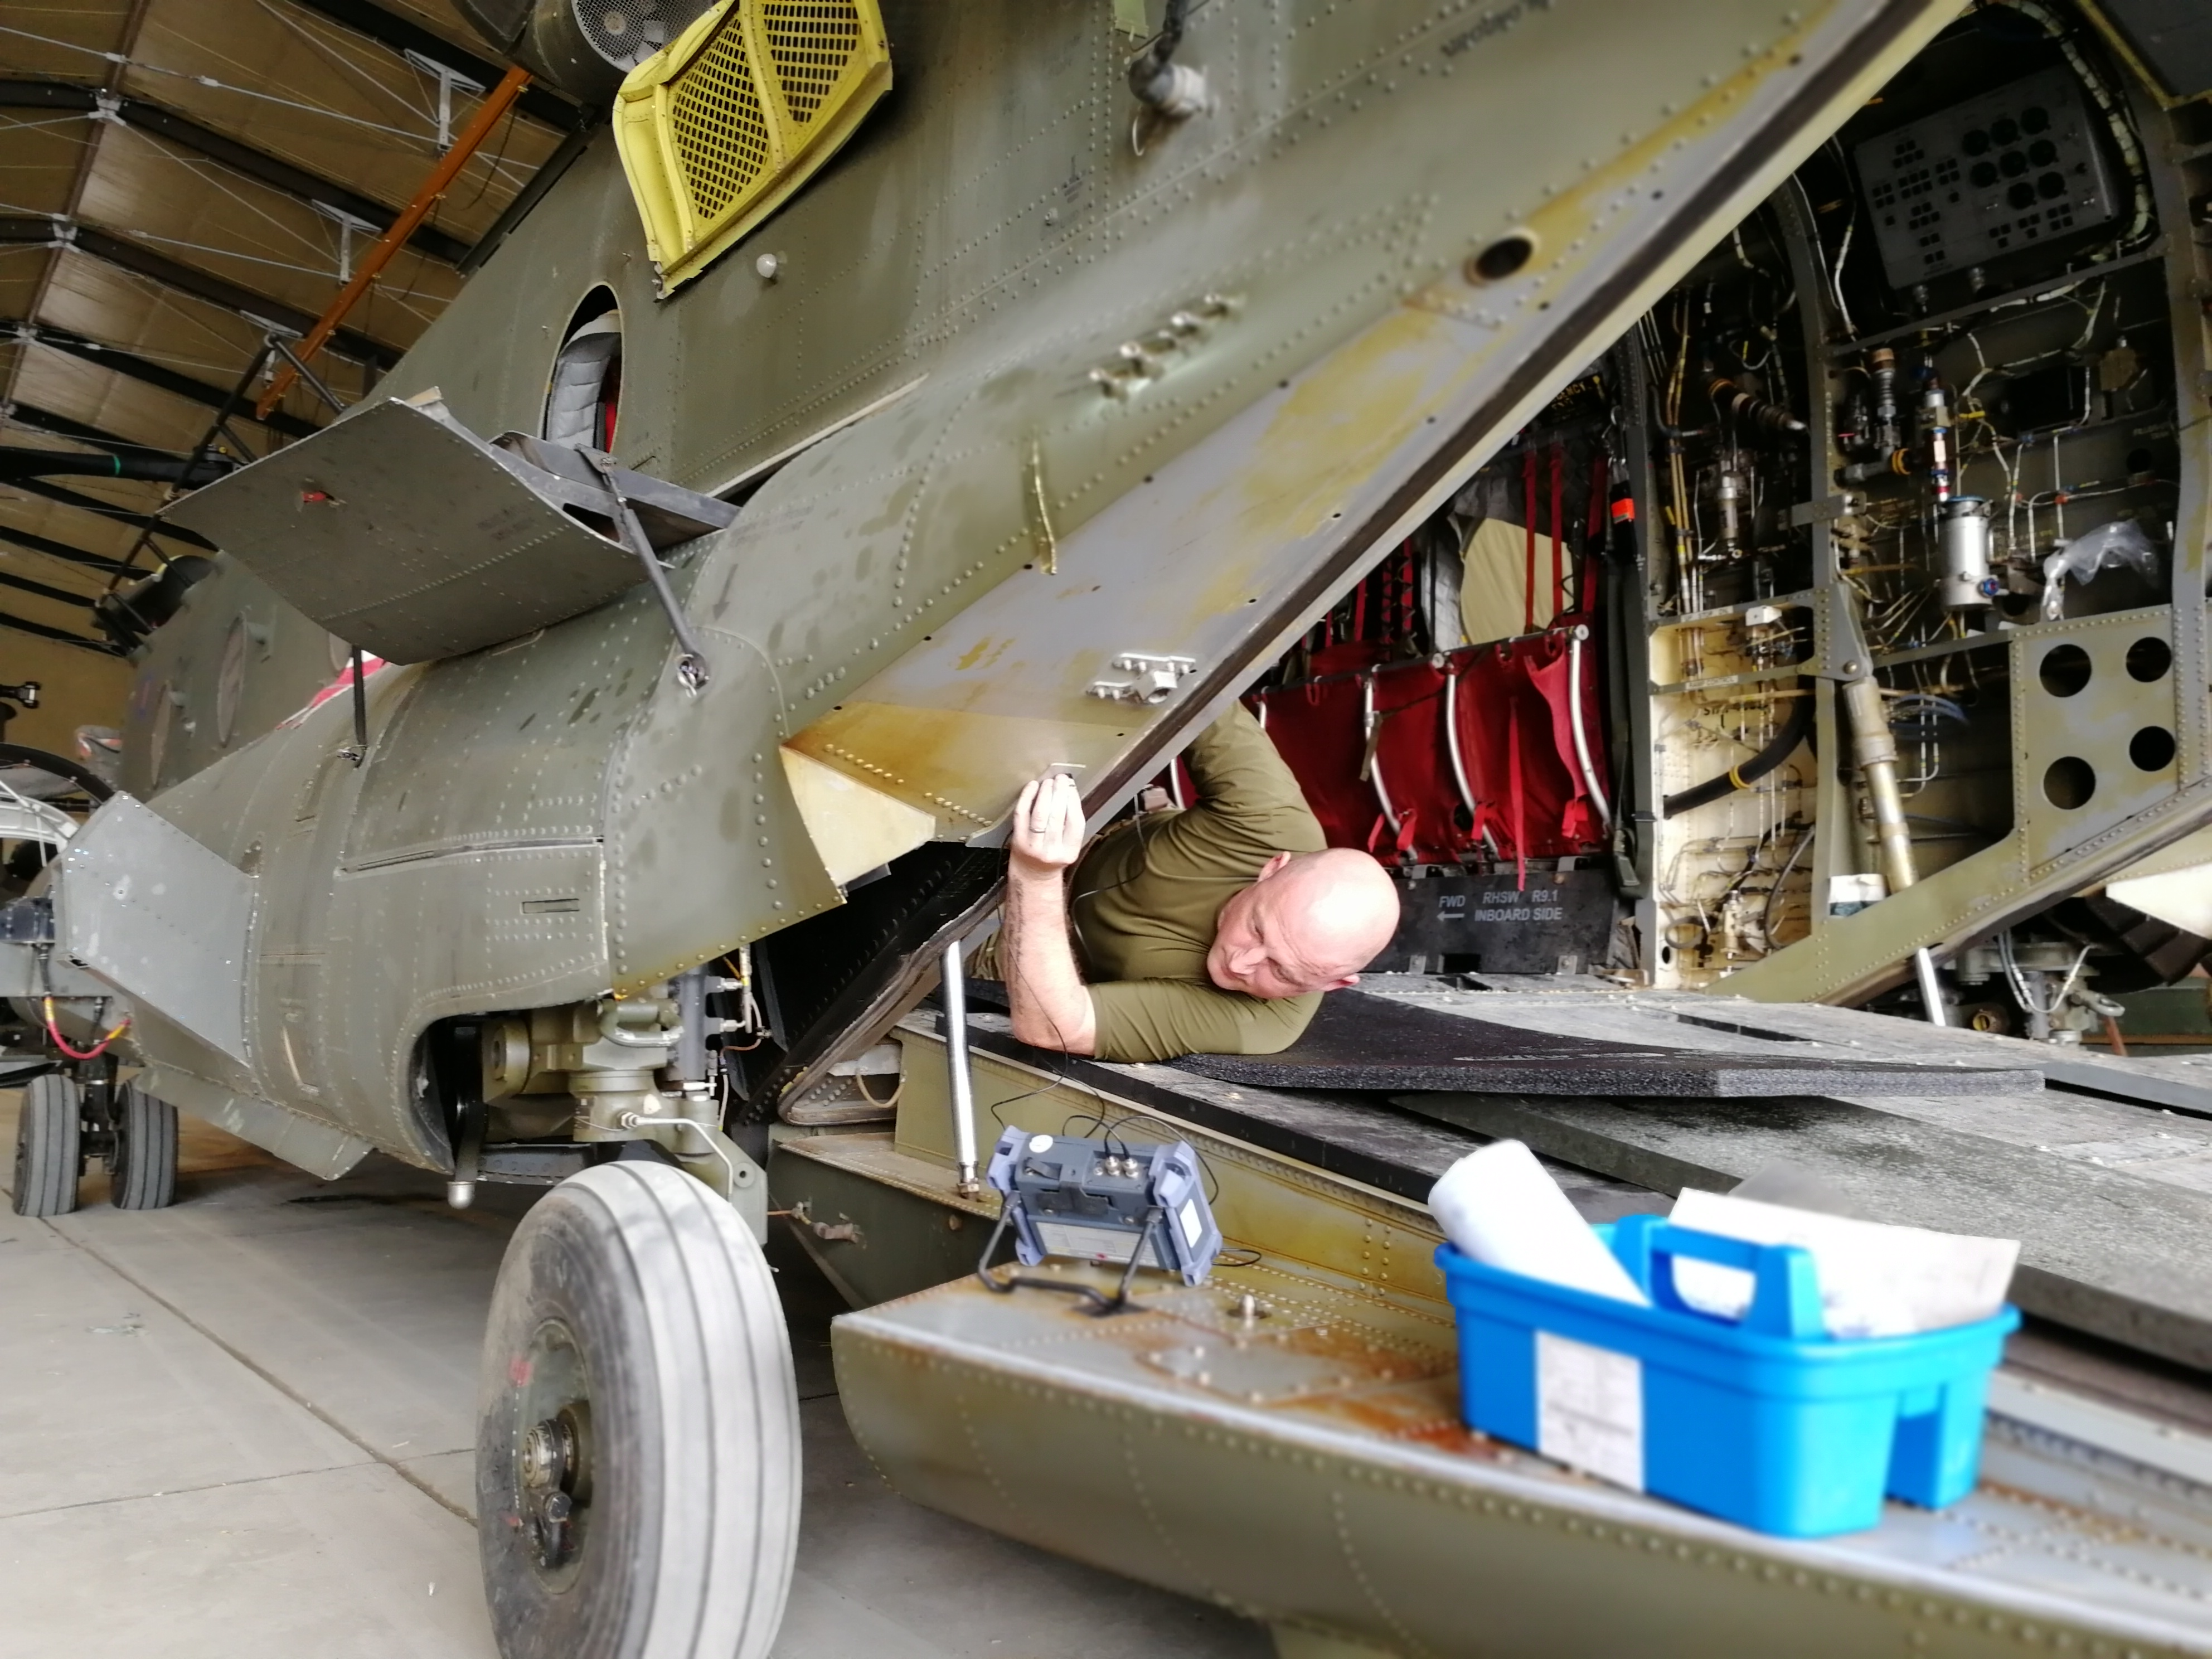
Examples of NDT carried out within the MOD
Notes:
These are all Chinook images but we can be expected to carry out any of the 5 Methods we are trained in on any of the in service platforms within the Military Air environment.

Slide 13
Summary
Basic construct of the MOD Air Command NDT specialisation
Form 7
A brief overview of:
Provisional Work Instructions
&
Formal NDT requests
Notes:
Today I have given a basic overview of the MOD (Royal air force) Air Command hierarchy
The requesting of NON routine NDT utilisng the form 7
And a brief insight into
Provisional work instructions and
Formal NDT requests.

Slide 14
REFERENCES USED Any further information can be sought by visiting JAP(D)100A-4179, 71 Sqn Order Book 2-1-3-6 and 2-1-3-7. MAM-P

Slide 15
Any Questions
Please contact
Martin.dodd615@mod.gov.uk
Or
doddmartin@hotmail.co.uk
Notes:
If you have any questions please add them to the discussion board for the QA at the end or send them to the email addresses above. Many thanks for listening today.

